Slide 1
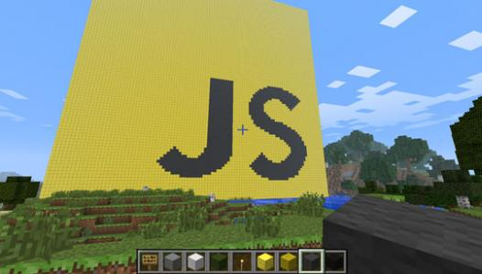
Writing Plugins in Minecraft with JavaScript
Getting Started

Slide 2
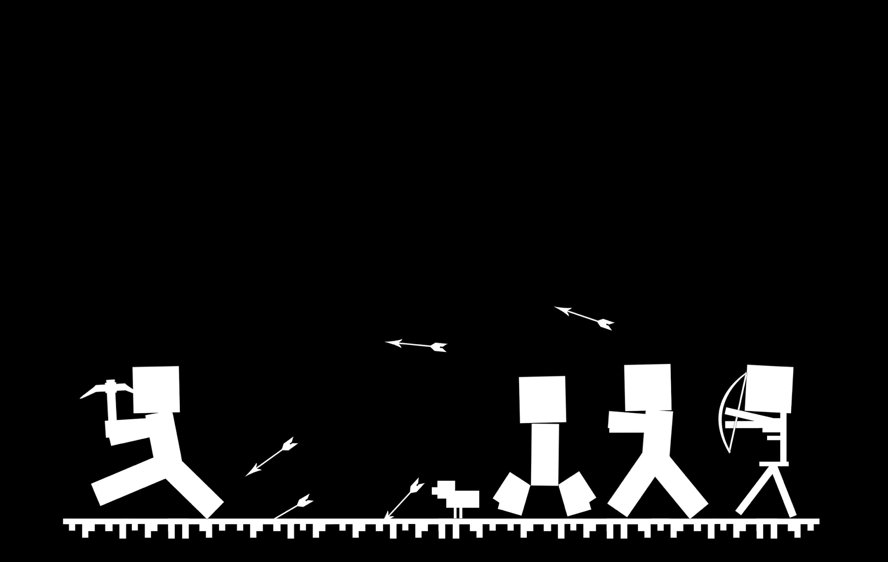
Getting Started

Slide 3

What You’ll Need
Minecraft (installed and running)
Java (if you have Minecraft running, then java is already installed)
Class source code: https://github.com/LetsCodeBlacksburg/ScriptCraft (download this to your desktop and unzip it)
Text editor (Sublime Text is recommended)

Slide 4

Installing CanaryMod

Slide 5
Find your OS’s launcher script
In ScriptCraft-master/:
Windows: Windows/run.bat
Mac: Mac/start_server.command
Linux: Linux/canarymod.sh
Copy this file into your server/ directory

Slide 6
Making the script executable (Mac/Linux only)
Open the terminal and type the following:
cd ~/Desktop/ScriptCraft-master/server
Mac: chmod a+x ./start_server.command
Linux: chmod a+x ./canarymod.sh

Slide 7
Accepting the EULA
Your server won’t start until you accept the terms of use.
In your text editor:
open ScriptCraft-master/server/eula.txt
change eula=false to eula=true

Slide 8
Connecting to your Server

Slide 9
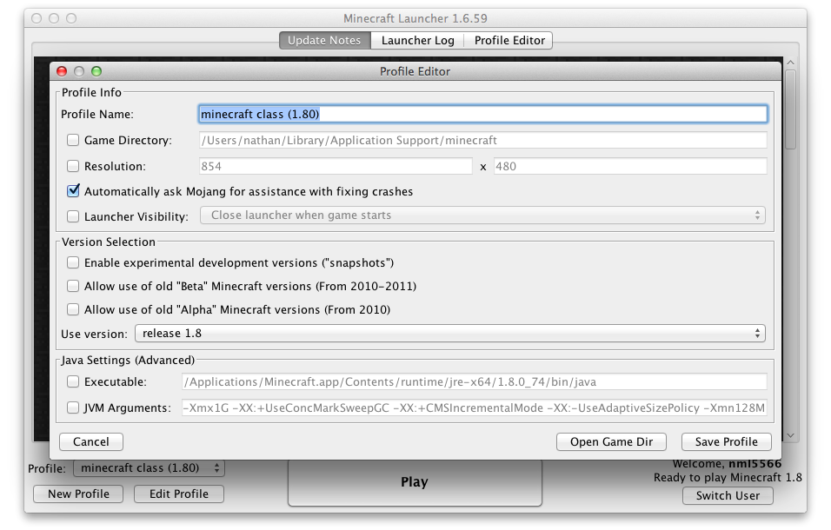
Minecraft Profile Editor
Click on the New Profile button
Create a profile that uses release version 1.8.0

Slide 10

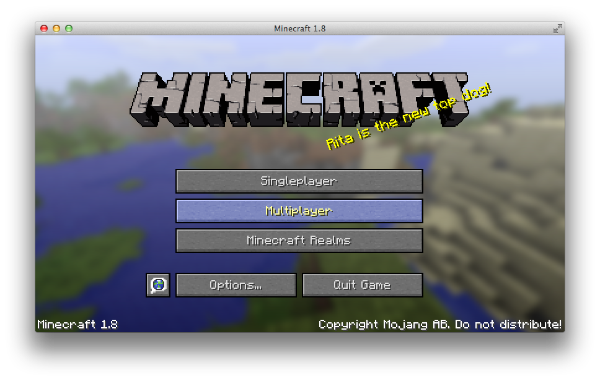
Connecting Client to Server
Launch the game and click on Multiplayer.
Next, click Add Server and type your server’s name

Slide 11
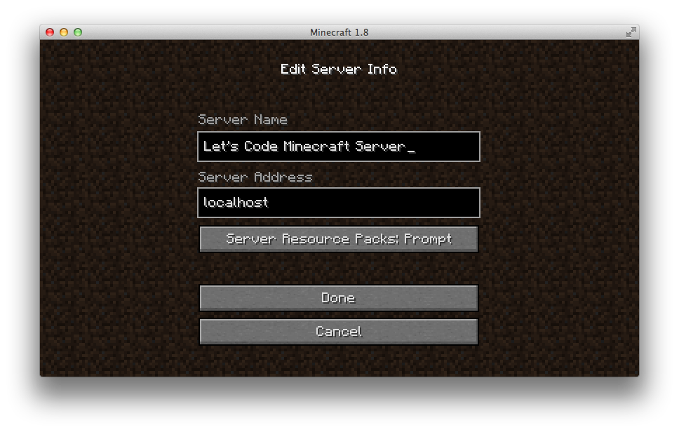
Adding Your Server
Give your server a distinct name.
Type localhost in the Server Address field.

Slide 12
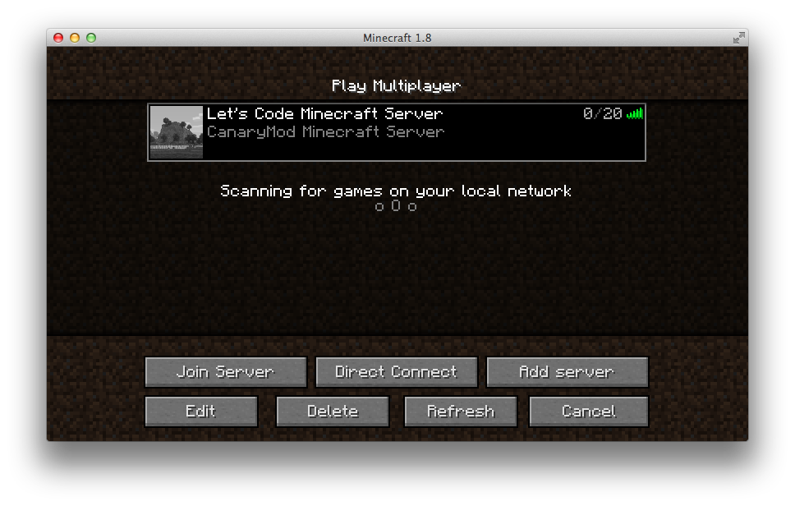
Joining Your Server
Try clicking Refresh if nothing shows up.

Slide 13
Installing ScriptCraft

Slide 14
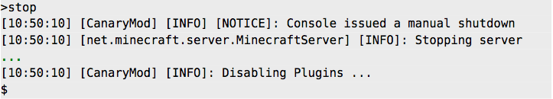
Adding ScriptCraft to Plugins
In ScriptCraft-master/plugins/:
Find scriptcraft.jar
Copy this file into your server/plugins/ directory
Restart the server (type the stop command into the server console, then relaunch it by double-clicking on your startup script)

Slide 15
Verifying ScriptCraft is Installed
Type the following command exactly into the server console:
js "Hello world"
The server console will also print the following:
[19:22:21] [CanaryMod] [INFO]: Enabling plugin ScriptCraft

Slide 16
Giving yourself OP
This is necessary to run JavaScript commands in-game and break blocks. You can only do this after you’ve logged into your server.
Type the following command exactly into the server console:
op <username>
The server console will print the following:
[11:31:09] [CanaryMod] [INFO]: [SERVER] Opped <username>

Slide 17
Exploring JavaScript in Minecraft

Slide 18
Running Commands
Console VS Client
Javascript commands run on in-game (on the client) must always start with a / (to open the chat window)
Console commands don’t need the /
Not every command works in both

Slide 19
Basic Math
Javascript can act as a calculator:
js 2 + 3
js 2 * 3
js 2 - 3
It can also compare numbers:
js 3 > 5
js 3 < 5
js 3 == 5

Slide 20
Storing Data in Variables
Start with a variable: | js var hearts
Set it to a value: | js hearts = 8
Check the current value: | js hearts
Change the value: | js hearts = 9
Do math with it: | js hearts + 5
 | js hearts - 2
 | js hearts * 1
 | js hearts / 3
 | NOTE: variables can’t begin with numbers

Slide 21
Strings
js "double string"
js 'single string'
js 'I\'m an escaped string'
js "Here’s a \"double-quote\" escaped string"
js "I'm un-escaped"
js var healthMessage = 'You have ' + hearts + " health remaining"

Slide 22
The null Keyword
js var hearts = null
null means “no value”. It’s useful for marking that a variable is empty.
This is different from undefined, which is the default initial setting for any declared variable.

Slide 23
Adding and Subtracting
js hungerBar = 0
js hungerBar = hungerBar + 1
js hungerBar += 1
js hungerBar = hungerBar + 1
js ++hungerBar
js hungerBar--

Slide 24
Data Types
Number
String
Boolean
Object
Undefined
Function
js typeof false
js typeof true
js typeof 5
js typeof 9.99
js typeof 'Hello'
js typeof "5"
js typeof console
js typeof Herobrine
js typeof parseInt

Slide 25
Functions
Collections of code that can be easily called and reused.
Values passed in between the ( and ) called parameters.
js parseInt('4 hours until sunset')
js parseInt('This is not a number')
js parseInt('3 blind mice')

Slide 26
Writing Your Own Functions
Type the following on one line *:
js function add(first, second) { return first + second; }
Call your new function:
js add(5, 6)
js add(9, 1)
* NOTE: If you get the error below, just ignore it
Error: InternalError: Cannot convert NaN to java.util.Iterator (<Unknown source>#415)

Slide 27
Creating Plugins

Slide 28
Your First Minecraft Plugin
In ScriptCraft-master/server/scriptcraft/plugins/:
create a new folder called learning/
use your text editor to create a file inside learning/ called helloWorld.js
Add the following inside your file:
console.log('Hello World');
Save your file, then type the following in the server console:
js refresh()

Slide 29
Making Your Code Reusable
Let’s put our helloWorld.js code into a function:
function helloWorld() {
console.log('Hello World');
}
And refresh our server:
js refresh()

Slide 30
What Happened to Our Message?
Add the new code and refresh:
function helloWorld() {
console.log('Hello World');
}
helloWorld();

Slide 31
Making helloWorld() public
To call functions directly, we must first export them:
function helloWorld() {
console.log('Hello World');
}
helloWorld();
exports.helloWorld = helloWorld;

Slide 32
Objects
Can hold other variables and functions (called properties) accessible via dot notation. exports is an example of this. self is another example that refers to you, the player.
Try this in-game (note the slash in front of the command):
/js self.health = 10
/js self.invisible = true
/js self.hunger = 10

Slide 33
Making A Dice Plugin

Slide 34
Rolling Dice
In ScriptCraft-master/server/scriptcraft/
create a new file in plugins/ called dice.js
add the code on the right
save and refresh
function roll(){
var result = Math.random();
result = result * 6;
result = Math.floor(result);
return result;
}
exports.roll = roll;

Slide 35
Multi-sided Die
You could define multiple functions for different dice sides (e.g. rollSixSides(), rollFourSides(), etc…), but that gets tiring.
It’s easier to pass the number of sides as a parameter.
Edit dice.js to add the changes on the right, refresh, and try it out using the code below:
js var dice = require("dice")
js dice.roll(6)
js dice.roll(20)
function roll( sides ){
var result = Math.random();
result = result * sides;
result = Math.floor(result);
return result;
}
exports.roll = roll;

Slide 36
Conditionals

Slide 37
If/Else/Else If
Useful for changing code based on different events:
var time = "noon";
if ( time == "morning" ) { echo("Time for breakfast!"); }
else if (time == "noon") { echo("Time for lunch!"); }
else if (time == "night") { echo("Time for dinner!"); }
else { echo(“Time for snacks!”); }

Slide 38
Combining Conditionals
&& represents and. || represents or.
Below is a more accurate time check script. Minecraft counts time in ticks (up to 24,000).
/js var world = self.world;
/js var now = world.relativeTime;
/js if (now > 13000 && now < 23000 ) { echo("Night!"); }
/js if (now < 13000 || now > 23000 ) { echo("Not night!"); }

Slide 39
function roll( sides ){
if ( isFinite(sides) && sides < 0 ) {
throw("Negative numbers not valid");
} else if (isFinite(sides) && sides > 0) {
return rollValidNumber(sides);
} else {
throw("Not a number");
}
}
function rollValidNumber( sides ){
var result = Math.random();
result = result * sides;
result = Math.floor(result);
return result;
}
exports.roll = roll;
Example of Using Conditionals to Make the Dice Roll Better

Slide 40
Arrays

Slide 41
Using Arrays
Arrays are objects than hold lists of items.
js var farmAnimals = [ 'Sheep','Cow','Pig','Chicken' ];
How do we access the list?
js echo(farmAnimals[0]); echo(farmAnimals[1]); echo(farmAnimals[2]);
js for (var count in farmAnimals) { echo(farmAnimals[count]); }
What if we print something outside the list?
echo(farmAnimals[5]);

Slide 42
Using Modules
Modules let you build reusable code. They can be imported into plugins and combined with other modules/functions.
Module exports aren’t auto-loaded, unlike plugin exports.
Let’s move dice.js to ScriptCraft-master/server/scriptcraft/modules
But how do we use it now?
js var dice = require("dice")
js dice.roll()

Slide 43
Random Spawner Plugin
Create a file called randomSpawner.js in your plugins/ folder:
var dice = require('dice');
var spawn = require('spawn');
var farmAnimals = ["cow", "chicken", "pig", "sheep"];
var total = farmAnimals.length; // .length gets # of elements
function randomSpawn() {
var result = dice.roll(total);
spawn(farmAnimals[result], self.location);
}
/* This command will only work in-game */
exports.randomSpawn = randomSpawn;

Slide 44
A Quick Note About Comments
Comments are notes in code that help explain what is happening. They are not read by the computer.
Single-Line comments
// anything after the // is a comment
var a = 1; // end of line comment
// multiple lines ...
// ... need multiple slashes
Multi-Line comments
/*
Anything inside here a comment
*/
Single-line comments can have // inside them. Multi-line can’t have /* or */ inside them

Slide 45
Even More Randomness
var dice = require('dice');
var spawn = require('spawn');
var entities = require('entities');
var entityNames = []; // empty array
/* push object properties into array to get total */
for (var name in entities){ entityNames.push(name); }
var total = entityNames.length;
function randomSpawn() {
var result = dice.roll(total);
echo("Spawning "+entityNames[result]); //show what spawned
spawn(entityNames[result], self.location);
}
exports.randomSpawn = randomSpawn;

Slide 46
Event-Driven Programming

Slide 47
Why Events?
You know how to write code for commands that you type while in-game.
You can also monitor what’s happening inside Minecraft so you can respond to it automatically.
There are roughly 200 events that can be responded to.
Examples:
playerMove()
playerDeath()
playerArmSwing()
blockPlace()
blockBreak()
portalCreate()
portalUse()
entityDeath()
entityShootBow()
itemUse()
itemDrop()
villagerTrade()
craft()

Slide 48
Greet Players On Server Join
Add a file in plugins/ called greetPlayer.js:
function greetPlayer( event ) {
var player = event.player;
var message = "Hi " + player.name;
echo( player, message );
};
events.connect( greetPlayer );

Slide 49
Stay Tuned for Part 2!
To be continued...

